Slide 1
Employee Management System using Microservices Architecture

Slide 2
Frontend – Angular 12 ( Used Angular Material UI )
Backend microservices - Golang 1.18,gorilla mux web framework
Database – MongoDB
6 Microservices – UI , Auth , Employee , Department , Payroll , Leave
Used Ingress Service to route incoming traffic.
Developed middleware for role based access.
AWS cloud for storing audit records and logs in S3 bucket
Use GitHub Actions for CI/CD pipeline
Deployed Application using Kubernetes and Docker technologies
Deployed Application on AWS cloud
For local testing – minikube with hyperV , Kubernetes cluster.

Slide 3

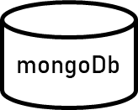
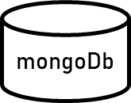
Architecture Diagram
Employee WebApp UI
REST
REST
Department Service
Payroll
Service
EmployeesService
Leave Management Service
Auth Service
mongoDb

Slide 4
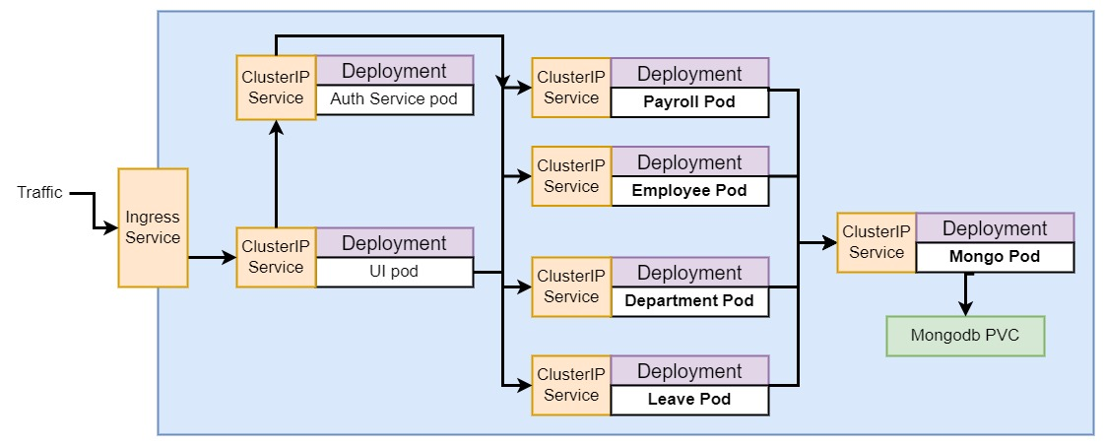
Architecture Diagram

Slide 5
Employee Management Service
Employee
Manager can perform extra tasks
View Employment Details
Create, Update, Delete a employee
Add or View Personal Info
( address , contact number , email ) to database
Add , Update Employee
Official Info (name , ID , designation , department ,salary ) to database
Searching , Filtering Employees based on attributes
Listing all Employees

Slide 6
Leave Management Service
Start
Employee initiates leave Request
Rejects & notifies employee
Manager Validates
notifies employee
Approves
Updates Records in database
End

Slide 7
Payroll Service
Get Employee Salary Details
Payroll Database
Pay Rate
Calculate monthly pay
Total Pay
Deduct Taxes
Net Pay
Issue Pay check
Employee

Slide 8
Department Service
View Department details
Manager
Add employee to a project team
Update Project deadlines and ask for report
Assign a role ( Project or Team lead , tech lead, staff )

Slide 9
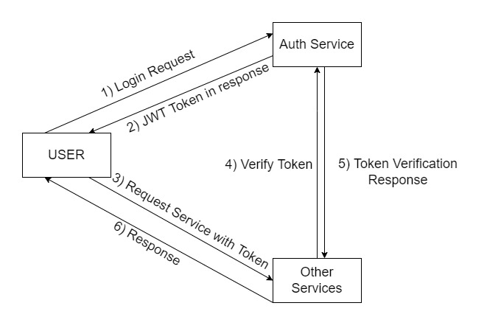
Authentication & Authorization Service

Slide 10
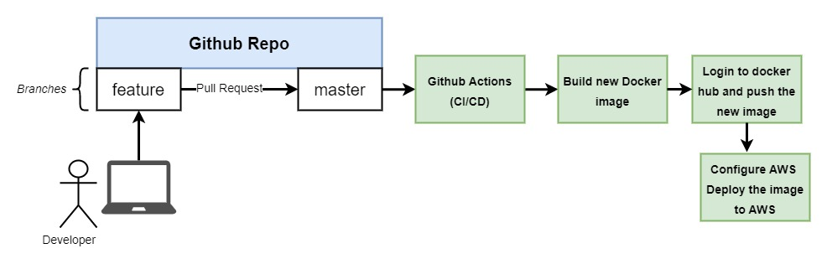
Deployment Workflow

Slide 11
Logging to S3 Bucket
Using Fluent-bit to collect logs from multiple containers and send them to S3 bucket.
Developed config map for using Fluent Bit to automate logging from containers every 10-30 minutes to S3 bucket.

